Slide 1
Who Pays for
the Energy Transition?
June 15, 2023
Matthew Keen, Partner
Michael Manhas, Partner

Slide 2
Table of Contents
Introduction & overview: who should pay for the clean energy transition?
Government
Public utilities and their regulators
Investors
Specific challenges
New generation & energy sources
New transmission & distribution infrastructure
New methods of energy consumption
Why who pays matters: five principles for policy-makers and regulators
Appendix: case studies

Slide 3
1. Introduction & Overview

Slide 4
Introduction
Decarbonization objectives are driving up the demand for clean energy
Society is transitioning away from GHG emitting energy sources and pursuing new clean energy technology
This transition will be expensive. Who should pay for it?
The government (i.e. taxpayers)?
Gas and electricity utility ratepayers?
Private investors?
In deciding this question, how do we ensure the transition is achieved efficiently and fairly?

Slide 5
Government
Canada’s provincial and federal governments have made achieving net-zero emissions a central goal
Direct investment into R&D and technologies
Direct and indirect control of emissions by others
Carbon taxes
Carbon credits
Commercialization of investment in carbon reduction
Proposed emission caps for specific industries
Options face efficiency trade-offs.

Slide 6
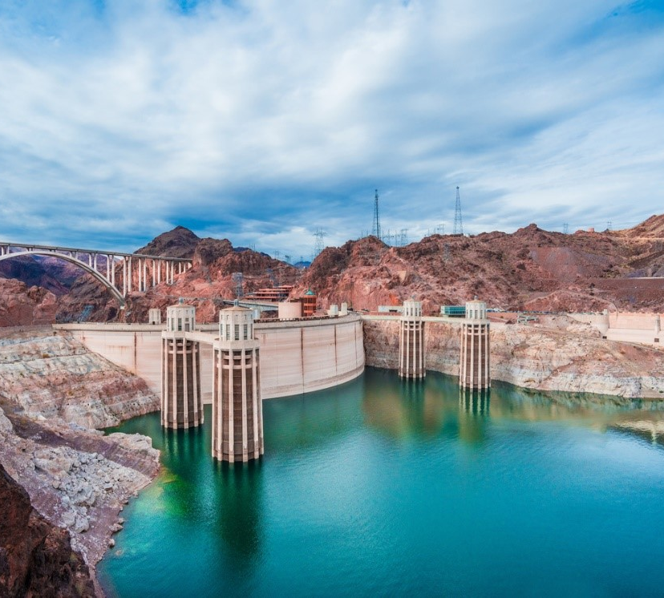
Public Utilities & Regulators
Energy markets = Natural monopolies
Economic regulation protects ratepayer interests by aiming to provide low cost, safe, reliable energy
Old paradigms face new wrinkles:
Reducing GHG emissions can be at odds with ratepayer interests
Regulators hence juggling the pursuit of clean energy with their responsibility to ratepayers
Examples at the AUC, OEB, BCUC

Slide 7
Investors
Private investment in green technology is on the rise
Response to government incentives and disincentives
Public-private partnerships
Grants and subsidies
Access to financing (e.g. funding for Indigenous partnerships in energy projects)
Tax consequences
Organizational investment to further ESG commitments, improve stakeholder relations, and/or stay competitive

Slide 8
2. Specific Challenges to the Roles of Government, Utilities, and Investors

Slide 9
New generation and new energy sources
GOAL: Decarbonize electricity generation to lower GHG emissions
1. Ratepayers bear the cost of building new generation
Large hydro projects, e.g. Site C.
2. Taxpayers bear the cost of building new generation
Alberta’s coal-to-gas transition led to five major recommendations by the Climate Leadership Panel in 2015, resulting in significant taxpayer-funded compensation to investors for lower-carbon generation
Ontario Power Generation is on Phase 1 of Canada’s first grid-scale small modular reactor, which is primarily funded by tax revenue

Slide 10
New generation and new energy sources
3. Policy makers shape markets to incentivize private-sector response
BC Hydro’s Clean Power Calls
Procurements intended to comply with requirements (a) that 90% of all electricity originate from clean sustainable sources, (b) that BC Hydro would be self sufficient, and (c) planning for dry years
Resulted in BC Hydro structurally purchasing independent power at above market prices and selling into Mid-C at market prices
Alberta’s Renewable Energy Program
Competitive procurement process with guaranteed per-MWh price for power through contracts for difference
Kicked off a large influx of private investment in wind and solar generation with no increase for taxpayers

Slide 11
Expanded transmission and distribution infrastructure
The burden of upgrading existing energy infrastructure to accommodate the energy transition largely falls on ratepayers, but how should the burden be distributed?
Two projects in BC both represent significant investment in transmission structure with different funding approaches
The $746 million Northwest Transmission Line was completed through $310 million from federal contributions (through Green Infrastructure Fund and AltaGas)
The remaining $436 million will be recovered from line users via a unique tariff at a rate set by BC Hydro that the BCUC was required to approve under s. 8(2) of the CEA
The $289 million Peace Region Electricity Supply was completed through $83.6 million from the federal government (through the Investing in Canada Plan)
The remaining $205.4 million was recovered more generally from BC Hydro ratepayers under s. 18 of the CEA, which requires the BCUC to allow public utilities to recover the costs of “prescribed undertakings”

Slide 12
Expanded transmission and distribution infrastructure
Balancing the interests of ratepayers and utility investors
Ontario Energy Board identified a need for distributed energy resources (DERs) to meet demands on electric distribution systems
However, the interests of distribution utilities and investors may not align with those of ratepayers
Adoption of third-party DERs may slow the deployment of efficient DERs
The Framework for Energy Innovation Report recognized that investment incentives are necessary to encourage distributors to deploy third-party DERs
Ratepayers or taxpayers
BC Hydro recently completed an Expression of Interest process for expanded transmission infrastructure on the BC North Coast
However, excess transmission infrastructure may require funds beyond just that of the traditional ratepayer service – who carries the risk in spending? (See AUC case study)

Slide 13
New methods of energy consumption
Consumer choices are changing
Taxpayers
EV funding: 2023 Federal Budget includes investment tax credits for clean technology manufacturing
Carbon taxes: federal backstop & provincial schemes
Policies: EV rebates & net zero power by 2035
Ratepayers
Even when governments allow utility providers to recover the cost of transitioning to clean energy, regulators must still ensure these recovery mechanisms are fair to ratepayers (See BCUC case study)

Slide 14
New methods of energy consumption
An offsets market supplements statutory measures such as carbon taxes to further incentivize organizations to reduce their carbon footprint
Organizations may engage in offsetting, where they invest in projects that reduce global GHG emissions to offset their operational activities where reduction cannot be reasonably attained
At the federal level, while the Greenhouse Gas Pollution Pricing Act imposes carbon taxes, the Clean Fuel Regulations establish a credit market for fuel producers and suppliers to trade carbon credits either for own use or for other parties to use in future years
In BC, under the low carbon fuel standard (LCFS) regime, lower-carbon fuel suppliers can sell their credits, earned by supplying fuels with a carbon intensity below the targets, to higher-carbon fuel suppliers.
Industry stakeholders have also been utilizing offsets to achieve net-zero emissions, when reducing physical emissions is not possible.

Slide 15
3. Why Who Pays Matters: Five Principles for Policy-Makers and Regulators

Slide 16
Why who pays matters
Limited capital and real resources means trade-offs have to be made
Economic inefficiency leaves money on the table
All else equal, wasted money is wasted opportunity to reduce GHGs
A variety of funding options should be pursued
Spend each dollar purposefully and with consideration of economic outcomes
We propose principles to help clarify thinking on these issues.

Slide 17
Principle 1: Prioritize private investment
Private markets and private investment should be leveraged where possible
Market forces operate no matter what
Speedy, driven by desire to maximize profits and minimize costs
Government intervention should facilitate the market by de-risking investment in clean energy
Private investment is preferable to utilities investment in competitive markets
More efficient, not concerned with natural monopoly
Utilities investment helps, but in some markets more than others

Slide 18
Principle 2: Spend public money efficiently
The public will likely bear a large share of the cost, so the goal should be to spend that money efficiently and fairly
Likely too late to rely on voluntary investments needed to achieve climate objectives, so public money will be spent
BUT this money should also be spent wisely
Subsidies:
Avoid unnecessarily competing with other jurisdictions
Target initiatives that create public benefits and reinvest profits back into the public
Focus on matters that are already within the government’s control (ex. electrifying transportation) while avoiding cannibalizing industry
Be careful with end-user subsidies (ex. EV rebates)

Slide 19
Principle 3: Not all public funding is created equally
Some funding sources could have disproportionate effects on the public
Requiring ratepayers to pay for clean energy costs could disproportionately affect lower-income households
Progressive taxation might be a more equitable option
Creative rate-setting solutions can help but are not a panacea
High electricity prices could discourage electrification
Taxpayer infrastructure funding (reallocation of carbon tax revenues) may provide more effective price signals

Slide 20
Principle 4: Inform the public
Regulators should provide policy makers and the public with a clear understanding of who is paying for what
More information allows everyone to make more efficient choices
Regulators are experts and are in the best position to inform spending choices
Aligns with public-interest mandate
Information could include the efficiency and effectiveness of current decarbonization measures
Doing so should not be considered to be wading into the political

Slide 21
Principle 5: The perfect must not be enemy of the good!
Funding the clean energy transition will always come with trade-offs
There are trade-offs associated with every solution
Relying only on “green” generation without carbon capture or offsets may delay or interfere with achieving net-zero.
But waiting for new low-cost technological breakthroughs to avoid moving away from GHG emitting fuel sources over time may also likely to be dangerous
Always remember the ultimate goal is to fight climate change

Slide 22
Questions?

Slide 23
4. Appendix: Case Studies

Slide 24
Case Study 1 – BC Utilities Commission (BCUC)
Cross-subsidization of EV charging operations with funds generated from ratepayers should be minimized.
The BCUC rejected BC Hydro’s proposed rates for EV charging services on the basis it was not just and reasonable, because it failed to recover BC Hydro’s cost of service
It would therefore distort the competitive market for EV charging service providers by creating an uneven playing field
In contrast, the BCUC approved FortisBC’s proposed rates for EV charging services because it did not pose a similar risk to the market and did not inflict undue burden on ratepayers
When regulators use ratepayers to fund these projects, they must ensure that their spending is fair and does not unjustifiably impede private investment

Slide 25
Case Study 2 – Alberta Utilities Commission (AUC)
“Only prudently incurred distribution infrastructure costs to enable hydrogen blending should be borne by ratepayers.”
The AUC recently considered blending hydrogen into the natural gas distribution system to reduce GHG emissions
Problem: The decrease in carbon taxes resulting from the lower GHG emissions is exceeded by the cost to utilities providers (ie. ratepayers) to integrate hydrogen
Solution: The AUC recommends the following incentives for utilities providers to shift some of the cost burden form ratepayers to taxpayers
Tax credits;
Tax rebates;
Public subsidies.

Slide 26
Norton Rose Fulbright US LLP, Norton Rose Fulbright LLP, Norton Rose Fulbright Australia, Norton Rose Fulbright Canada LLP and Norton Rose Fulbright South Africa Inc are separate legal entities and all of them are members of Norton Rose Fulbright Verein, a Swiss verein. Norton Rose Fulbright Verein helps coordinate the activities of the members but does not itself provide legal services to clients.
References to ‘Norton Rose Fulbright’, ‘the law firm’ and ‘legal practice’ are to one or more of the Norton Rose Fulbright members or to one of their respective affiliates (together ‘Norton Rose Fulbright entity/entities’). No individual who is a member, partner, shareholder, director, employee or consultant of, in or to any Norton Rose Fulbright entity (whether or not such individual is described as a ‘partner’) accepts or assumes responsibility, or has any liability, to any person in respect of this communication. Any reference to a partner or director is to a member, employee or consultant with equivalent standing and qualifications of the relevant Norton Rose Fulbright entity.
The purpose of this communication is to provide general information of a legal nature. It does not contain a full analysis of the law nor does it constitute an opinion of any Norton Rose Fulbright entity on the points of law discussed. You must take specific legal advice on any particular matter which concerns you. If you require any advice or further information, please speak to your usual contact at Norton Rose Fulbright.

